Slide 1
GIS and spatial analytics
Lecture 4

Slide 2
Today:
MORE Census
Details about spatial data in GIS
Reshaping data in GIS
GIS magic
Can reshape spatial layers and related data in large number of ways
Will walk you through many ways to reshape your data
Types of Merges
Spatial Joins

Slide 3
Overview of Census Shapefiles
Overview of Census Shapefiles
Types of Shapefiles:
Counties, Tracts, Blocks:
Each level offers varying detail.
Boundary Files:
Define administrative and statistical areas.
Usage in GIS:
Base maps for demographic analysis.
Layers for spatial joins and overlays with other data.

Slide 4
We Link Shapes with Attributes
1 (set of polygons)
Spatial data
2
3
3
(Shapefiles)
4
5
COV# ZONE ZIP
1
0
2
C-19
22060
Attribute data
3
3
A-4
A-4
22061
22061
4
C-22
22060
(Tables functions)
5
A-5
22057
Notes:
Storage: For small GIS projects it may be sufficient to store geographic information as simple files. There comes a point, however, when data volumes become large and the number of data users becomes more than a few, that it is best to use a database There are many different designs of DBMSs, but in GIS the relational design has been the most useful. A DBMS is nothing more than computer software for managing a database--an integrated collection of data. In the relational design, data are stored conceptually as a collection of tables. Common fields in different tables are used to link them together. This surprisingly simple design has been so widely used primarily because of its flexibility and very wide deployment in applications both within and without GIS.

Slide 5
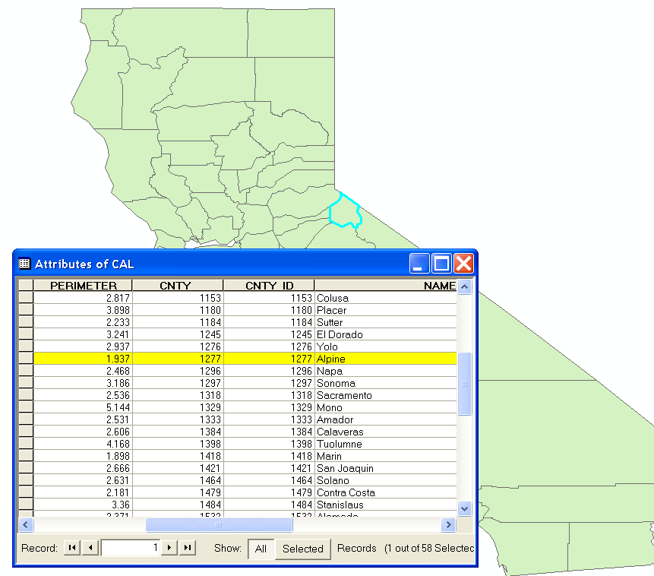
Example

Slide 6
Spatial Data Description and Management
Relating and Joining Data
Spatial Queries and Measurement
Manipulating data at multiple levels

Slide 7
Common Spatial Analysis Tools
Map Overlay Tools
Union, Intersect, Identity, Erase, Symmetrical Difference
Point in Polygon, Line in Polygon, Polygon on Polygon
Clip, Select, Split, Table Select
Proximity Tools
Buffer, Multiple Ring Buffer, Near, Point Distance
Statistics
Frequency, Summary Statistics

Slide 8
Adding Spatial Layers
Overlay function creates new “layers” to solve spatial problems
Notes:
The overlay operation is one the most powerful functions in a GIS. It gives the user the ability to place the cartographic representation of thematic data over one another.
However, this is hardly a new function developed by a GIS, but it has been revolutionized by the use of the computerized GIS.

Slide 9
Spatial Overlays
Spatially combine two layers to:
Generate a new output data layer
Assign attributes of one data layer to another
Usually one of the data layers will be polygons
A point-in-polygon overlay is typical

Slide 10
Examples:
In which zip code are survey respondents located? Campaign donors?
In which census tracts do we find Walmart stores? Payday lenders?
How proximate to liquor stores and bars do most crimes occur?

Slide 11
Important Map Overlay Tools
Intersect
Union
Identity
Erase
Symmetrical Difference

Slide 12
Two Basic Overlay Tools
Some of the basic overlay tools for vector data are UNION,
and INTERSECT corresponding to Boolean operations of OR, AND
A
B
A
B
UNION
OR
A
B
A
B
INTERSECT
AND

Slide 13
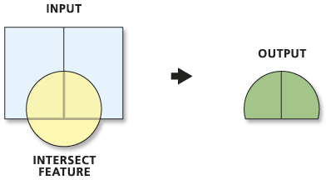
Intersect
This tool builds a new feature class from the intersecting features common in both feature classes.

Slide 14
How Intersect Works
The Intersect tool calculates the geometric intersection of any number of feature classes and feature layers. The features or portion of features that are common to (intersect) all inputs will be written to the Output Feature Class.
Discovers geometric relationships (intersections) between features from all the feature classes or layers.
Writes these intersections as features (point, line, or polygon) to the output.
The inputs can be any combination of geometry types (point, multipoint, line, polygon).

Slide 15
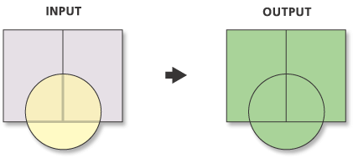
Union
This tool builds a new feature class by combining the features and attributes of each feature class.

Slide 16
How Union Works
Union calculates the geometric intersection of any number of feature classes and feature layers.
All inputs must be of a common geometry type and the output will be of that same geometry type. This means that a number of polygon feature classes and feature layers can be unioned together. The output features will have the attributes of all the input features that they overlap.
Discovers geometric relationships (overlap) between features from all feature classes.
Writes the new features to the output.
Union will discover the overlap between features. The areas where features overlap will be separated into new features with all the attribute information of the input feature.

Slide 17
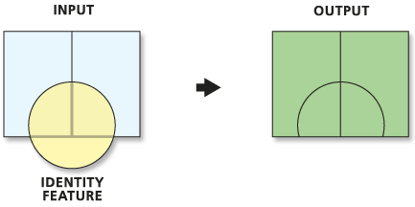
Identity
This tool combines the portions of features that overlap the identity features to create a new feature class.

Slide 18
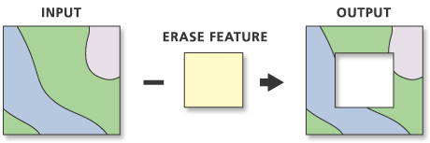
Erase
This tool creates a feature class from those features or portions of features outside the erase feature class.

Slide 19
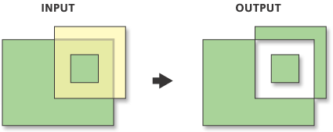
Symmetrical Difference
This tool creates a feature class from those features or portions of features that are not common to any of the other inputs.

Slide 20
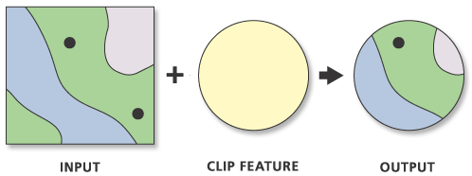
Clip: Very Helpful!
Extracts those features or portions of features from an input feature class that overlap with a clip feature class.
The Clip tool is similar to the Intersect tool, however, the Clip tool does not transfer any attributes from the clip feature class to the output.

Slide 21
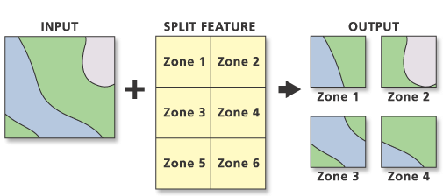
Split
The spatial extraction of features by clipping portions of the input feature class into multiple feature classes.

Slide 22
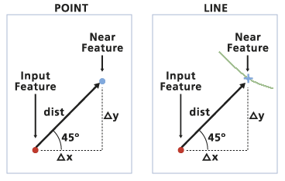
Near
Computes the distance from each point in a feature class to the nearest line or point in another feature class.

Slide 23
Common Errors
One-to-many, vs. one-to-one joins
Intend a one-to-one join
Result is a one-to-many join
Be careful with islands
Every polygon in a shapefile gets a record, even if it belongs to the same unit

Slide 24
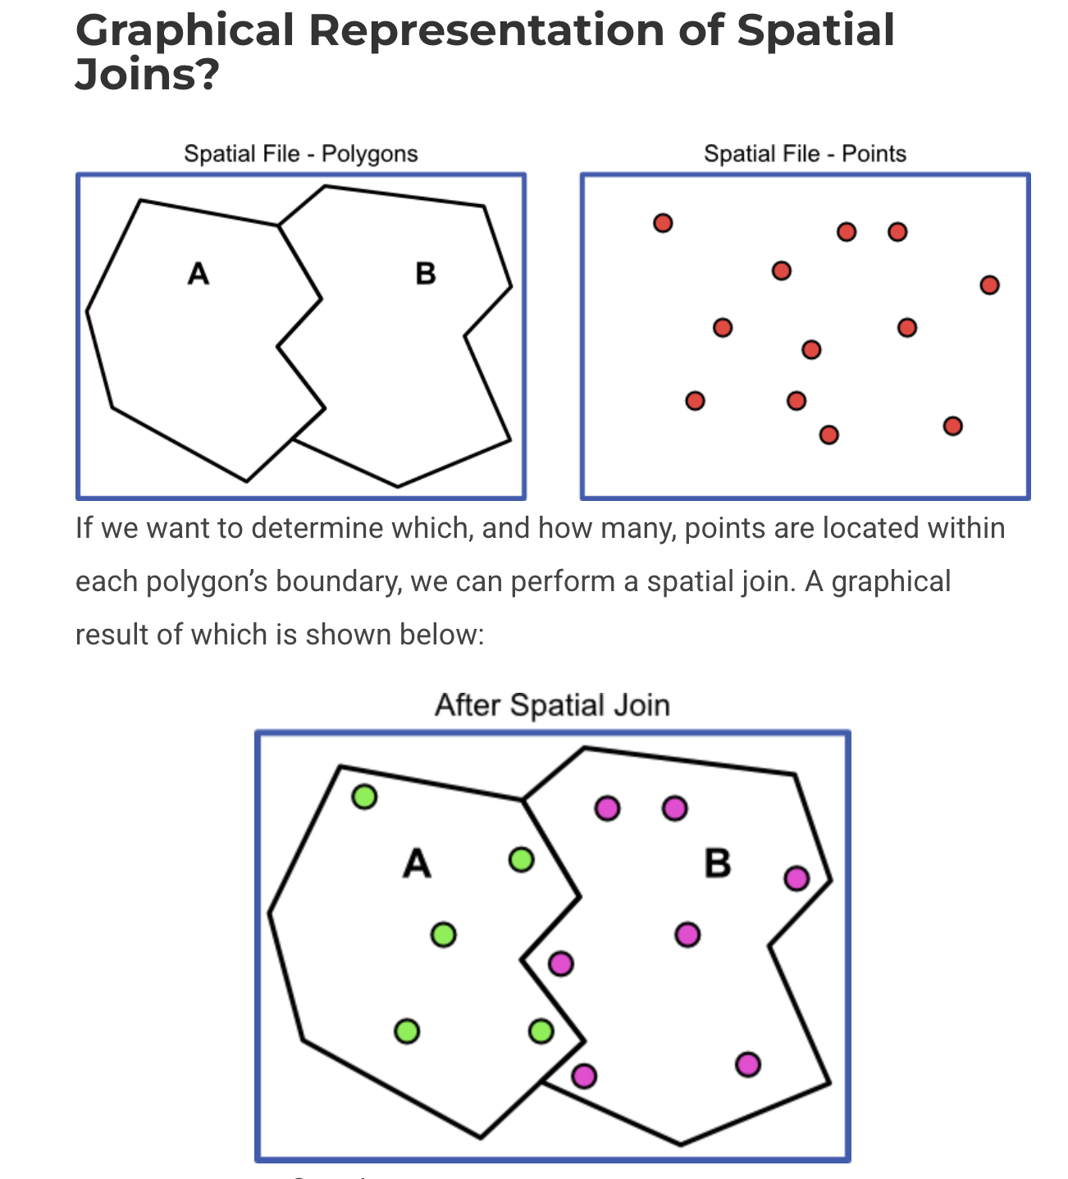
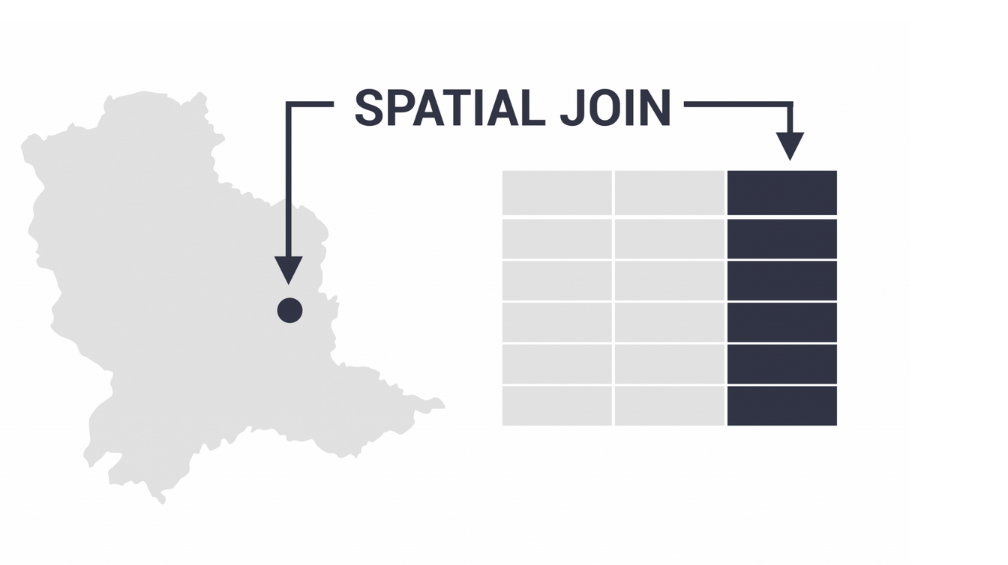

Slide 25
Single Parts vs. Multiple Parts
If there are islands, a unit (state, province) must be drawn as a multi-part feature in the shapefile (the spatial data)
Then there will be only one row in the attribute table
If each island is drawn as a separate feature, there will be multiple rows in the attribute table

Slide 26
Multi-Part vs. Single-Part
We join the state population figures to
a file of states, here to a multi-part
shapefile
Note the population
sum is wrong here

Slide 27
Merge and Single-to-Multi-part Commands
Merge – takes single-part features and merges to multi-part
Explode – goes from multi- to single, making the parts of multi-part features independent
These work on all features in a layer rather than just selected features when used via the geoprocessing tools in QGIS

